Slide 1
V5R2
V1R1
Chang Chenchen/cwx594171
2019.12.03

Slide 2
Huawei VRP Basics

Slide 3
The Versatile Routing Platform (VRP) is a universal operating system (OS) platform for Huawei datacom products. It is based on IP and adopts a component-based architecture. It provides rich features and functions, including application-based tailorable and extensible functions, greatly improving the running efficiency of the devices that use this OS. To efficiently manage such devices, you must be familiar with VRP and VRP-based configuration.
This course describes the basic concepts, common commands, and command line interface (CLI) of VRP.

Slide 4
On completion of this course, you will be able to:
Understand VRP basics.
Learn how to use CLI.
Master basic CLI commands.

Slide 5
VRP Overview
Command Line Basics

Slide 6
What Is VRP?
VRP is a universal OS platform for Huawei datacom products. It serves as the software core engine of Huawei's full series of routers from low-end to core ones, Ethernet switches, service gateways, and so on.
VRP provides the following functions:
Provides a unified user interface and a unified management interface.
Implements the functions of the control plane and defines the interface specifications of the forwarding plane.
Implements communication between the device forwarding plane and VRP control plane.
VRP
Security
Routing
Wireless
Switching

Slide 7
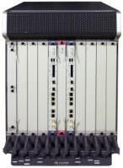

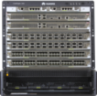

Development of the VRP
VRP1
Centralized design
Applicable to low-end and mid-range devices
Low performance
Centralized
VRP2
Some NE series routers
Distributed design
AR series routers
1998-2001
1999-2000
VRP3
S series switches
Some CE series switches
Distributed
Distributed platform
Support for various features
Support for core routers
VRP5
VRP8
Component-based design
Applicable to various Huawei products
High performance
Multi-process
Component-based design
Support for multi-CPU and multi-chassis
High reliability
Multi-process, multi-chassis, and multi-core
2000-2004
2004-Now
2009-Now

Slide 8
File System
The file system manages files and directories in storage media, allowing users to view, create, rename, and delete directories and copy, move, rename, and delete files.
Mastering the basic operations of the file system is crucial for network engineers to efficiently manage the configuration files and VRP system files of devices.
The system software is a must for device startup and operation, providing support, management, and services for a device. The common file name extension is .cc.
A configuration file stores configuration commands, enabling a device to start with the configurations in the file. The common file name extensions are .cfg, zip, and .dat.
System Software
Configuration File
Patch File
PAF
File
A patch is a kind of software compatible with the system software. It is used to fix bugs in system software. The common file name extension is .pat.
A PAF file effectively controls product features and resources. The common file name extension is .bin.
Common File Types
Notes:
A configuration file is a collection of command lines. Current configurations are stored in a configuration file so that the configurations are still effective after the device restarts. Users can view configurations in the configuration file and upload the configuration file to other devices to implement batch configuration.
A patch is a kind of software compatible with the system software. It is used to fix bugs in system software. Patches can also fix system defects and optimize some functions to meet service requirements.
To manage files on a device, log in to the device through either of the following modes:
Local login through the console port or Telnet
Remote login through FTP, TFTP, or SFTP

Slide 9
Storage Media
Storage media include SDRAM, flash memory, NVRAM, SD card, and USB.
NVRAM
NVRAM is nonvolatile random access memory. It is used to store log buffer files. Logs will be written into the flash memory after the timer expires or the buffer is full.
Flash
The flash memory is nonvolatile and can avoid data loss in case of power-off. It is used to store system software, configuration files, and so on. Patch files and PAF files are uploaded by maintenance personnel and generally stored in the flash memory or SD card.
SD Card
The SD card can avoid data loss data in case of power-off. The SD card has a large storage capacity and is generally installed on a main control board. It is used to store system files, configuration files, log files, and so on.
SDRAM
SDRAM is synchronous dynamic random access memory, which is equivalent to a computer's memory. It stores the system running information and parameters.
Storage Media
USB
The USB is considered an interface. It is used to connect to a large-capacity storage medium for device upgrade and data transmission.
Notes:
Storage media include SDRAM, flash memory, NVRAM, SD card, and USB.
SDRAM stores the system running information and parameters. It is equivalent to a computer's memory.
NVRAM is nonvolatile. Writing logs to the flash memory consumes CPU resources and is time-consuming. Therefore, the buffer mechanism is used. Specifically, logs are first saved to the buffer after being generated, and then written to the flash memory after the timer expires or the buffer is full.
The flash memory and SD card are nonvolatile. Configuration files and system files are stored in the flash memory or SD card. For details, see the product documentation.
SD cards are external memory media used for memory expansion. The USB is considered an interface. It is used to connect to a large-capacity storage medium for device upgrade and data transmission.
Patch and PAF files are uploaded by maintenance personnel and can be stored in a specified directory.

Slide 10
Device Initialization Process
After a device is powered on, it runs the BootROM software to initialize the hardware and display hardware parameters. Then, it runs the system software and reads the configuration file from the default storage path to perform initialization.
BIOS Creation Date : Jan 5 2013, 18:00:24
DDR DRAM init : OK
Start Memory Test ? ('t' or 'T' is test):skip
Copying Data : Done
Uncompressing : Done
……
Press Ctrl+B to break auto startup ... 1
Now boot from flash:/AR2220E-V200R007C00SPC600.cc,
……
Notes:
Boot Read-Only Memory (BootROM) is a set of programs added to the ROM chip of a device. BootROM stores the device's most important input and output programs, system settings, startup self-check program, and system automatic startup program.
The startup interface provides the information about the running program of the system, the running VRP version, and the loading path.

Slide 11
Device Management
There are two commonly used device management modes: CLI and web system.
To use a device management mode, you must first log in to a device through a login mode supported by this device management mode.
Web System
CLI
The web system provides a graphical user interface (GUI) for easy device management and maintenance. This method, however, can be used to manage and maintain only some, not all, device functions.
The web system supports the HTTP and HTTPS login modes.
The CLI requires users to use commands provided by a device to manage and maintain the device. This mode implements refined device management but requires users to be familiar with the commands.
The CLI supports the console port, Telnet, and SSH login modes.

Slide 12
VRP User Interfaces
When a user logs in to a device through a CLI-supported mode, the system allocates a user interface to manage and monitor the current session between the user terminal and device.
Such a user interface can be a console user interface or virtual type terminal (VTY) user interface.
Console User Interface
VTY User Interface
A console user interface is used to manage and monitor users who log in to a device through the console port.
The serial port of a user terminal can be directly connected to the console port of a device for local access.
The VTY user interface is used to manage and monitor users who log in to a device by means of VTY.
After a Telnet or STelnet connection is established between a user terminal and a device, a VTY channel is established to implement remote access to the device.

Slide 13
VRP User Levels
VRP provides basic permission control functions. It defines the levels of commands that each level of users can execute to restrict the operations of users at different levels.
User Level | Command Level | Name | Available Command
0 | 0 | Visit level | Network diagnosis commands (such as ping and tracert), commands for accessing external devices from the local device (such as Telnet client commands), and some display commands
1 | 0 and 1 | Monitoring level | System maintenance commands, including display commands
2 | 0, 1, and 2 | Configuration level | Service configuration commands, including routing commands and IP configuration commands, to directly provide users with network services
3-15 | 0, 1, 2, and 3 | Management level | Commands for controlling basic system operations and providing support for services, including the file system, FTP, TFTP download, user management, and command level commands, as well as debugging commands for fault diagnosis
Notes:
To limit users' access permissions to a device, the device manages users by level and establishes a mapping between user levels and command levels. After a user logs in to a device, the user can use only commands of the corresponding levels or lower. By default, the user command level ranges from 0 to 3, and the user level ranges from 0 to 15. The mapping between user levels and command levels is shown in the table.

Slide 14




Login to the Web System
Take the web system for a Huawei AR router as an example. Start a browser on a PC, enter https://192.168.1.1 in the address bar, and press Enter. Then, the web system login page is displayed.
192.168.1.1
Notes:
Note: The login page, mode, and IP address may vary according to devices. For details, see the product documentation.

Slide 15

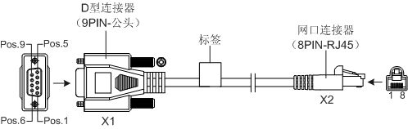
CLI - Local Login (1)
You can log in to a device in local or remote mode. Local login mode:
Use this mode when you need to configure a device that is powered on for the first time. You can use the console port of the device for a local login.
The console port is a serial port provided by the main control board of a device.
To implement the login, directly connect your terminal's serial port to the device's console port, and use PuTTY to log in to the device. You can then configure the device after the login succeeds.
AR2220
Console port
Console cable
COM port
PC
Notes:
Use a console cable to connect the console port of a device with the COM port of a computer. You can then use PuTTY on the computer to log in to the device and perform local commissioning and maintenance. A console port is an RJ45 port that complies with the RS232 serial port standard. At present, the COM ports provided by most desktop computers can be connected to console ports. In most cases, a laptop does not provide a COM port. Therefore, a USB-to-RS232 conversion port is required if you use a laptop.
The console port login function is enabled by default and does not need to be pre-configured.

Slide 16
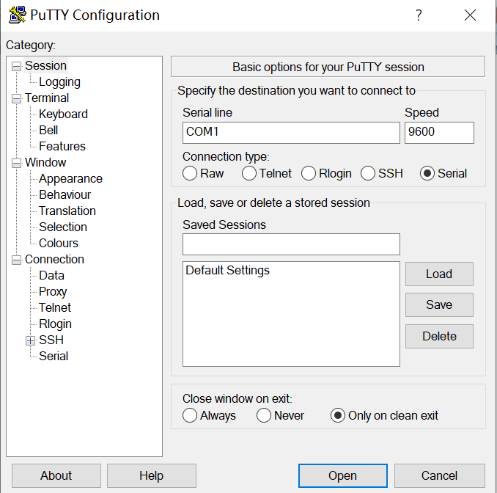
CLI - Local Login (2)
PuTTY is a connection software for login through Telnet, SSH, serial interfaces, and so on.
In local login, the terminal is connected to the console port of the Huawei device through a serial port. Therefore, set Connection type to Serial. Set Serial line based on the actually used port on the terminal. Set Speed to 9600.
Notes:
Many terminal simulators can initiate console connections. PuTTY is one of the options for connecting to VRP. If PuTTY is used for access to VRP, you must set port parameters. The figure in the slide shows examples of port parameter settings. If the parameter values were ever changed, you need to restore the default values.
After the settings are complete, click Open. The connection with VRP is then set up.

Slide 17
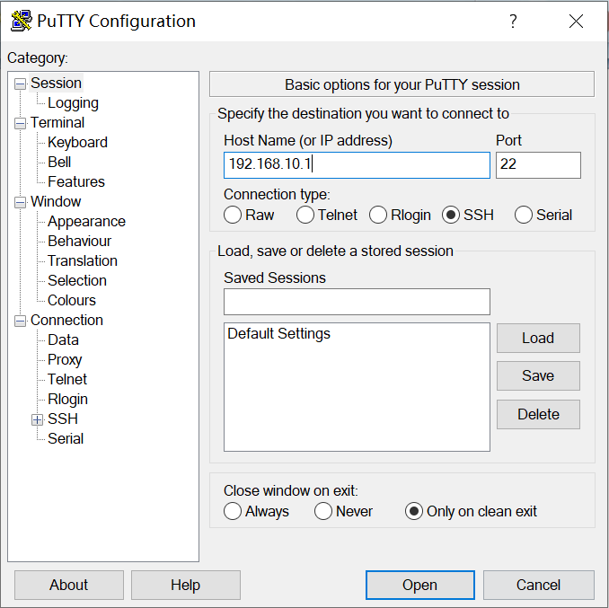
CLI - Remote Login
Remote login means that you log in to a device that can function as a remote login server, allowing you to centrally manage and maintain network devices. Remote login methods include Telnet and SSH.
If you use the SSH login mode, set Connection type to SSH, enter the IP address of the remote login server, and use the default port number 22.
If you use the Telnet login mode, set Connection type to Telnet, enter the IP address of the remote login server, and use the default port number 23.
192.168.10.1
Notes:
By default, the SSH login function is disabled on a device. You need to log in to the device through the console port and configure mandatory parameters for SSH login before using the SSH login function.

Slide 18
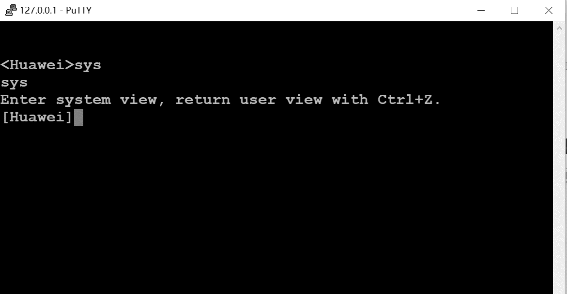
CLI
After a login succeeds, the command line interface (CLI) is displayed.
The CLI is a common tool for engineers to interact with network devices.
AR2220
Console port
Console cable
COM port
PC
Notes:
The CLI is an interface through which users can interact with a device. When the command prompt is displayed after a user logs in to a device, it means that the user has entered the CLI successfully.

Slide 19
VRP Basics
Command Line Basics
Command Line Overview
Basic Configuration Commands
Case Analysis

Slide 20
Basic Command Structure
CLI commands follow a unified structure. After a command is entered on the CLI, the CLI parses the command and executes it to implement the function of the command, such as query, configuration, or management.
Parameter List
Command Word
Keyword
Parameter name
Parameter value
Command word: specifies the operation to be executed in a command, such as display (device status query) or reboot (device restart).
Keyword: a special character string that is used to further restrict a command. It is an extension of a command and can also be used to express the command composition logic.
Parameter list: is composed of parameter names and values to further restrict the command function. It can contain one or more pairs of parameter names and values.
Example 1:
display ip interface GE0/0/0: displays interface information.
Command word: display
Keyword: ip
Parameter name: interface
Parameter value: GE0/0/0
Example 2:
reboot: restarts a device.
Command word: reboot
Each operation command must start with a command word, and the command word is selected from the standard command word list.
Notes:
Each command must contain a maximum of one command word and can contain multiple keywords and parameters. A parameter must be composed of a parameter name and a parameter value.
The command word, keywords, parameter names, and parameter values in a command are separated by spaces.

Slide 21
Command Views (1)
A device provides various configuration and query commands. To facilitate the use of these commands, VRP registers the commands in different views according to their functions.
Interface views:
GigabitEthernet interface view
Ethernet interface view
Serial interface view
...
User view: In this view, you can check the running status and statistics of a device.
System view: In this view, you can set system parameters and enter the configuration views of other commands.
Other views: In other views, such as the interface view and protocol view, you can set interface parameters and protocol parameters.
Protocol views:
OSPF view
IS-IS view
BGP view
User view
System view
OSPF area view
...
Notes:
The user view is the first view displayed after you log in to a device. Only query and tool commands are provided in the user view.
In the user view, only the system view can be accessed. Global configuration commands are provided in the system view. If the system has a lower-level configuration view, the command for entering the lower-level configuration view is provided in the system view.

Slide 22
Command Views (2)
View name
View prompt
[Huawei-GigabitEthernet0/0/1]
Interface view
interface GigabitEthernet 0/0/1
<Huawei>
[Huawei]
system-view
quit
User view
System view
quit
ospf 1
[Huawei-ospf-1]
quit
Protocol view
return
Command examples:
<Huawei>system-view #This command is used to enter the system view from the user view. The user view is the first view that is displayed after you log in to a device.
[Huawei]interface GigabitEthernet 0/0/1 #This command is used to enter the interface view from the system view.
[Huawei-GigabitEthernet0/0/1]ip address 192.168.1.1 24 #This command is used to set an IP address.
[Huawei-GigabitEthernet0/0/1]quit #This command is used to return to the previous view.
[Huawei]ospf 1 #This command is used to enter the protocol view from the system view.
[Huawei-ospf-1]area 0 #This command is used to enter the OSPF area view from the OSPF view.
[Huawei-ospf-1-area-0.0.0.0]return #This command is used to return to the user view.
Notes:
After you log in to the system, the user view is displayed first. This view provides only display commands and tool commands, such as ping and telnet. It does not provide any configuration commands.
You can run the system-view command in the user view to enter the system view. The system view provides some simple global configuration commands.
In a complex configuration scenario, for example, multiple parameters need to be configured for an Ethernet interface, you can run the interface GigabitEthernet X command (X indicates the number of the interface) to enter the GE interface view. Configurations performed in this view take effect only on the specified GE interface.

Slide 23
Editing a Command (1)
The CLI of a device provides basic command editing functions. Common editing functions are as follows:
1. Command editing through function keys
Backspace: deletes the character before the cursor and moves the cursor to the left. When the cursor reaches the beginning of the command, an alarm is generated.
Left cursor key ← or Ctrl+B: moves the cursor one character to the left. When the cursor reaches the beginning of the command, an alarm is generated.
Right cursor key → or Ctrl+F: moves the cursor one character to the right. When the cursor reaches the end of the command, an alarm is generated.
2. Incomplete keyword input
A device allows the input of incomplete keywords. Specifically, if an entered character string can match a unique keyword, you do not need to enter the remaining characters of the keyword.
<Huawei>d cu
<Huawei>di cu
<Huawei>dis cu
<Huawei>d c
^
Error:Ambiguous command found at '^' position.
<Huawei>dis c
^
Error:Ambiguous command found at '^' position.
For example, the display current-configuration command is identified when you enter d cu, di cu, or dis cu. However, the command cannot be identified if you enter d c or dis c because the character string d c or dis c matches more than one command.
Notes:
Note: "keyword" mentioned in this section means any character string except a parameter value string in a command. The meaning is different from that of "keyword" in the command format.

Slide 24
Editing a Command (2)
3. Command editing through the Tab key
If an entered character string matches a unique keyword, the system automatically supplements the keyword after you press Tab. If the keyword is complete, it remains unchanged even if you press Tab repeatedly.
If an entered character string matches more than one keyword, you can press Tab repeatedly. The system will then circularly display the keywords beginning with the entered character string to help you find the desired keyword.
If an entered character string cannot identify any keyword, the entered string remains unchanged after you press Tab.
[Huawei] info- #Press Tab.
[Huawei] info-center
[Huawei] info-center log #Press Tab.
[Huawei] info-center logbuffer #Press Tab repeatedly to circularly display all matched keywords.
[Huawei] info-center logfile
[Huawei] info-center loghost
[Huawei] info-center loglog #Enter an incorrect keyword and press Tab.
[Huawei] info-center loglog

Slide 25
Using Command Line Online Help
You can use command line online help to obtain real-time help without memorizing a large number of complex commands.
The online help can be classified into full help and partial help. To obtain the online help, enter a question mark (?) when using a command.
Full Help
Partial Help
To obtain full help, press ? after a view displayed. The system will then display all commands in the view and their descriptions.
To obtain partial help, press ? after you enter the start character or character string of a command. The system will then display all the commands that start with this character or character string.
<Huawei> ?
User view commands:
arp-ping ARP-ping
autosave <Group> autosave command group
backup Backup information
cd Change current directory
clear Clear
clock Specify the system clock
...
<Huawei> d?
debugging <Group> debugging command group
delete Delete a file
dialer Dialer
dir List files on a filesystem
display Display information
Notes:
The command help information displayed in this slide is for reference only, which varies according to devices.

Slide 26
Interpreting Command Line Error Messages
If a command passes the syntax check, the system executes it. Otherwise, the system reports an error message.
[Huawei] sysname
^
Error:Incomplete command found at ‘^’ position. #A supplement needs to be made at the position pointed by the arrow.
[Huawei] router if 1.1.1.1
^
Error: Unrecognized command found at ‘^’ position. #An identification failure occurs at the position pointed by the arrow. Check whether the command is correct.
[Huawei] a
^
Error: Ambiguous command found at '^' position. #More than one command matches the keyword at the position pointed by the arrow. In this example, it indicates that there are multiple keywords starting with a.
[Huawei-GigabitEthernet0/0/0]ospf cost 800000 #The parameter value at the position pointed by the arrow is invalid.
^
Error: Wrong parameter found at '^' position.

Slide 27
Using Undo Command Lines
If a command begins with the keyword undo, it is an undo command. An undo command is generally used to restore a default configuration, disable a function, or delete a configuration. For example:
Run an undo command to restore a default configuration.
<Huawei> system-view
[Huawei] sysname Server
[Server] undo sysname
[Huawei]
Run an undo command disable a function.
<Huawei> system-view
[Huawei] ftp server enable
[Huawei] undo ftp server
Run an undo command to delete a configuration.
[Huawei]interface g0/0/1
[Huawei-GigabitEthernet0/0/1]ip address 192.168.1.1 24
[Huawei-GigabitEthernet0/0/1]undo ip address

Slide 28
Using Command Line Shortcut Keys
A device provides command shortcut keys to speed up and simplify command input.
Command shortcut keys are classified into user-defined shortcut keys and system shortcut keys.
User-defined Shortcut Keys
System Shortcut Keys
There are four user-defined shortcut keys: Ctrl+G, Ctrl+L, Ctrl+O, and Ctrl+U.
You can associate a user-defined shortcut key with any command. After you press a shortcut key, the system will automatically run the command associated with the shortcut key.
CTRL_A: moves the cursor to the beginning of the current line.
CTRL_B: moves the cursor one character to the left.
CTRL_C: stops the running of the current command.
CTRL_E: moves the cursor to the end of the current line.
CTRL_X: deletes all characters on the left of the cursor.
CTRL_Y: deletes the character at the cursor and all characters on the right of the cursor.
CTRL_Z: returns to the user view.
CTRL+]: terminates the current connection or switches to another connection.
<Huawei> system-view
[Huawei] hotkey ctrl_l "display tcp status"

Slide 29
VRP Basics
Command Line Basics
Command Views and Use of Command Views
Basic Configuration Commands
Case Analysis

Slide 30
Common File System Operation Commands (1)
1. Check the current directory.
<Huawei>pwd
2. Display information about files in the current directory.
<Huawei>dir
3. Display the content of a text file.
<Huawei>more
4. Change the current working directory.
<Huawei>acd
5. Create a directory.
<Huawei>makdir
Notes:
VRP uses the file system to manages files and directories on a device. To manage files and directories, you often need to run basic commands to query file or directory information. Such commonly used basic commands include pwd, dir [/all] [ filename | directory ], and more [ /binary ] filename [ offset ] [ all ].
The pwd command displays the current working directory.
The dir [/all] [ filename | directory ] command displays information about files in the current directory.
The more [/binary] filename [ offset ] [ all ] command displays the content of a text file.
In this example, the dir command is run in the user view to display information about files in the flash memory.
Common commands for operating directories include cd directory, mkdir directory, and rmdir directory.
The cd directory command changes the current working directory.
The mkdir directory command creates a directory. A directory name can contain 1 to 64 characters.

Slide 31
Common File System Operation Commands (2)
6. Delete a directory.
<Huawei>rmdir
7. Copy a file.
<Huawei>copy
8. Move a file.
<Huawei>move
9. Rename a file.
<Huawei>rename
10. Delete a file.
<Huawei>delete
Notes:
The rmdir directory command deletes a directory from the file system. A directory to be deleted must be empty; otherwise, it cannot be deleted using this command.
The copy source-filename destination-filename command copies a file. If the target file already exists, the system displays a message indicating that the target file will be replaced. The target file name cannot be the same as the system startup file name. Otherwise, the system displays an error message.
The move source-filename destination-filename command moves a file to another directory. The move command can be used to move files only within the same storage medium.
The rename old-name new-name command renames a directory or file.
The delete [/unreserved] [ /force ] { filename | devicename } command deletes a file. If the unreserved parameter is not specified, the deleted file is moved to the recycle bin. A file in the recycle bin can be restored using the undelete command. However, if the /unreserved parameter is specified, the file is permanently deleted and cannot be restored any more. If the /force parameter is not specified in the delete command, the system displays a message asking you whether to delete the file. However, if the /force parameter is specified, the system does not display the message. filename specifies the name of the file to be deleted, and devicename specifies the name of the storage medium.

Slide 32
Common File System Operation Commands (3)
11. Restore a deleted file.
<Huawei>undelete
12. Permanently delete a file in the recycle bin.
<Huawei>reset recycle-bin
Notes:
The reset recycle-bin [ filename | devicename ] command permanently deletes all or a specified file in the recycle bin. filename specifies the name of the file to be permanently deleted, and devicename specifies the name of the storage medium.

Slide 33
Basic Configuration Commands (1)
1. Configure a system name.
[Huawei] sysname name
2. Configure a system clock.
<Huawei> clock timezone time-zone-name { add | minus } offset
This command configures a local time zone.
<Huawei> clock datetime [ utc ] HH:MM:SS YYYY-MM-DD
This command configures the current or UTC date and time.
<Huawei> clock daylight-saving-time
This command configures the daylight saving time.
Notes:
Generally, more than one device is deployed on a network, and the administrator needs to manage all devices in a unified manner. The first task of device commissioning is to set a system name. A system name uniquely identifies a device. The default system name of an AR series router is Huawei, and that of an S series switch is HUAWEI. A system name takes effect immediately after being set.
To ensure successful coordination with other devices, you need to correctly set the system clock. System clock = Coordinated Universal Time (UTC) ± Time difference between the UTC and the time of the local time zone. Generally, a device has default UTC and time difference settings.
You can run the clock datetime command to set the system clock of the device. The date and time format is HH:MM:SS YYYY-MM-DD. If this command is run, the UTC is the system time minus the time difference.
You can also change the UTC and the system time zone to change the system clock.
The clock datetime utc HH:MM:SS YYYY-MM-DD changes the UTC.
The clock timezone time-zone-name { add | minus } offset command configures the local time zone. The UTC is the local time plus or minus the offset.
If a region adopts the daylight saving time, the system time is adjusted according to the user setting at the moment when the daylight saving time starts. VRP supports the daylight saving time function.

Slide 34
Basic Configuration Commands (2)
3. Configure a command level.
[Huawei] command-privilege level level view view-name command-key
This command configures a level for commands in a specified view. Command levels are classified into visit, monitoring, configuration, and management, which are identified by the numbers 0, 1, 2, and 3, respectively.
4. Configure the password-based login mode.
[Huawei]user-interface vty 0 4
[Huawei-ui-vty0-4]set authentication password cipher information
This user-interface vty command displays the virtual type terminal (VTY) user interface view, and the set authentication password command configures the password authentication mode. The system supports the console user interface and VTY user interface. The console user interface is used for local login, and the VTY user interface is used for remote login. By default, a device supports a maximum of 15 concurrent VTY-based user accesses.
5. Configure user interface parameters.
[Huawei] idle-timeout minutes [ seconds ]
This command sets a timeout period to disconnect from the user interface. If no command is entered within the specified period, the system tears down the current connection. The default timeout period is 10 minutes.
Notes:
Each type of user interface has a corresponding user interface view. A user interface view is a command line view provided by the system for you to configure and manage all physical and logical interfaces working in asynchronous interaction mode, implementing unified management of different user interfaces. Before accessing a device, you need to set user interface parameters. The system supports console and VTY user interfaces. The console port is a serial port provided by the main control board of a device. A VTY is a virtual line port. A VTY connection is set up after a Telnet or SSH connection is established between a user terminal and a device, allowing the user to access the device in VTY mode. Generally, a maximum of 15 users can log in to a device through VTY at the same time. You can run the user-interface maximum-vty number command to set the maximum number of users that can concurrently access a device in VTY mode. If the maximum number of login users is set to 0, no user can log in to the device through Telnet or SSH. The display user-interface command displays information about a user interface.
The maximum number of VTY interfaces may vary according to the device type and used VRP version.

Slide 35
Basic Configuration Commands (3)
6. Configure an IP address for an interface.
[Huawei]interface interface-number
[Huawei-interface-number]ip address ip address
This command configures an IP address for a physical or logical interface on a device.
7. Display currently effective configurations.
<Huawei>display current-configuration
8. Save a configuration file.
<Huawei>save
9. Check saved configurations.
<Huawei>display saved-configuration
Notes:
To run the IP service on an interface, you must configure an IP address for the interface. Generally, an interface requires only one IP address. For the same interface, a newly configured primary IP address replaces the original primary IP address.
You can run the ip address { mask | mask-length } command to configure an IP address for an interface. In this command, mask indicates a 32-bit subnet mask, for example, 255.255.255.0; mask-length indicates a mask length, for example, 24. Specify either of them when configuring an IP address.
A loopback interface is a logical interface that can be used to simulate a network or an IP host. The loopback interface is stable and reliable, and can also be used as the management interface if multiple protocols are deployed.
When configuring an IP address for a physical interface, check the physical status of the interface. By default, interfaces are up on Huawei routers and switches. If an interface is manually disabled, run the undo shutdown command to enable the interface after configuring an IP address for it.

Slide 36
Basic Configuration Commands (4)
10. Clear saved configurations.
<Huawei>reset saved-configuration
11. Check system startup configuration parameters.
<Huawei> display startup
This command displays the system software for the current and next startup, backup system software, configuration file, license file, and patch file, as well as voice file.
12. Configure the configuration file for next startup.
<Huawei>startup saved-configuration configuration-file
During a device upgrade, you can run this command to configure the device to load the specified configuration file for the next startup.
13. Restart a device.
<Huawei>reboot
Notes:
The reset saved-configuration command deletes the configurations saved in a configuration file or the configuration file. After this command is run, if you do not run the startup saved-configuration command to specify the configuration file for the next startup or the save command to save current configurations, the device uses the default parameter settings during system initialization when it restarts.
The display startup command displays the system software for the current and next startup, backup system software, configuration file, license file, and patch file, as well as voice file.
The startup saved-configuration configuration-file command configures the configuration file for the next startup. The configuration-file parameter specifies the name of the configuration file for the next startup.
The reboot command restarts a device. Before the device reboots, you are prompted to save configurations.

Slide 37
VRP Basics
Command Line Basics
Command Views and Use of Command Views
Basic Configuration Commands
Case Analysis

Slide 38
Case 1: File Query Commands and Directory Operations
Requirement description:
Check information about files and directories in the current directory of a router named RTA.
Create a directory named test, and then delete the directory.
<Huawei>pwd
flash:
<Huawei>dir
Directory of flash:/
Idx Attr Size(Byte) Date Time(LMT) FileName
0 drw- - Dec 27 2019 02:54:09 dhcp
1 -rw- 121,802 May 26 2014 09:20:58 portalpage.zip
2 -rw- 2,263 Dec 27 2019 02:53:59 statemach.efs
3 -rw- 828,482 May 26 2014 09:20:58 sslvpn.zip
1,090,732 KB total (784,464 KB free)
<Huawei>mkdir test
<Huawei>dir
Directory of flash:/
Idx Attr Size(Byte) Date Time(LMT) FileName
0 drw- - Dec 27 2019 02:54:39 test
1 drw- - Dec 27 2019 02:54:09 dhcp
2 -rw- 121,802 May 26 2014 09:20:58 portalpage.zip
3 -rw- 2,263 Dec 27 2019 02:53:59 statemach.efs
4 -rw- 828,482 May 26 2014 09:20:58 sslvpn.zip
1,090,732 KB total (784,460 KB free)
<Huawei>rmdir test
RTA

Slide 39
Case 2: File Operations (1)
Requirement description:
Rename the huawei.txt file save.zip.
Make a copy for the save.zip file and name the copy file.txt.
Move the file.txt file to the dhcp directory.
Delete the file.txt file.
Restore the deleted file file.txt.
<Huawei>rename huawei.txt save.zip
<Huawei>dir
Directory of flash:/
Idx Attr Size(Byte) Date Time(LMT) FileName
0 drw- - Mar 04 2020 04:39:52 dhcp
1 -rw- 121,802 May 26 2014 09:20:58 portalpage.zip
2 -rw- 828,482 Mar 04 2020 04:51:45 save.zip
3 -rw- 2,263 Mar 04 2020 04:39:45 statemach.efs
4 -rw- 828,482 May 26 2014 09:20:58 sslvpn.zip
1,090,732 KB total (784,464 KB free)
<Huawei>copy save.zip file.txt
<Huawei>dir
Directory of flash:/
Idx Attr Size(Byte) Date Time(LMT) FileName
0 drw- - Mar 04 2020 04:39:52 dhcp
1 -rw- 121,802 May 26 2014 09:20:58 portalpage.zip
2 -rw- 828,482 Mar 04 2020 04:51:45 save.zip
3 -rw- 2,263 Mar 04 2020 04:39:45 statemach.efs
4 -rw- 828,482 May 26 2014 09:20:58 sslvpn.zip
5 -rw- 828,482 Mar 04 2020 04:56:05 file.txt
1,090,732 KB total (784,340 KB free)
RTA

Slide 40
Case 2: File Operations (2)
Requirement description:
Rename the huawei.txt file save.zip.
Copy the save.zip file to the file.txt file.
Move the file.txt file to the dhcp directory.
Delete the file.txt file.
Restore the deleted file file.txt.
<Huawei>move file.txt flash:/dhcp/
<Huawei>cd dhcp
<Huawei>dir
Directory of flash:/dhcp/
Idx Attr Size(Byte) Date Time(LMT) FileName
0 -rw- 98 Dec 27 2019 02:54:09 dhcp-duid.txt
1 -rw- 121,802 Dec 27 2019 03:13:50 file.txt
1,090,732 KB total (784,344 KB free)
<Huawei>delete file.txt
<Huawei>dir
Directory of flash:/dhcp/
Idx Attr Size(Byte) Date Time(LMT) FileName
0 -rw- 98 Dec 27 2019 02:54:09 dhcp-duid.txt
1,090,732 KB total (784,340 KB free)
<Huawei>undelete file.txt
<Huawei>dir
Directory of flash:/dhcp/
Idx Attr Size(Byte) Date Time(LMT) FileName
0 -rw- 98 Dec 27 2019 02:54:09 dhcp-duid.txt
1 -rw- 121,802 Dec 27 2019 03:13:50 file.txt
1,090,732 KB total (784,340 KB free)
RTA

Slide 41
Case 3: VRP Basic Configuration Commands
As shown in the figure, an engineer needs to configure a router. The requirements are as follows:
Connect the router and PC. Assign the IP addresses shown in the figure to the router and PC.
Allow other employees of the company to use the password huawei123 to remotely log in to the router through the PC. Allow them to view configurations but disable them from modifying configurations.
Save current configurations and name the configuration file huawei.zip. Configure this file as the configuration file for the next startup.
GE0/0/1
192.168.1.1/24
192.168.1.2/24
AR1
PC1

Slide 42
Configuration Procedure (1)
GE0/0/1
192.168.1.1/24
192.168.1.2/24
AR1
PC1
Configure an interface IP address.
Configuring a user level and a user authentication mode.
<Huawei>system-view
[Huawei]sysname AR1
[AR1]interface GigabitEthernet 0/0/1
[AR1-GigabitEthernet0/0/1]ip address 192.168.1.1 24
[AR1-GigabitEthernet0/0/1]quit
[AR1]user-interface vty 0 4
[Huawei-ui-vty0-4]authentication-mode password
Please configure the login password (maximum length 16):huawei123
[AR1-ui-vty0-4]user privilege level 1
[AR1-ui-vty0-4]quit
The password configuration command may vary according to devices. For details, see the product documentation.
Notes:
For some devices, after the authentication-mode password command is entered, the password setting page will be displayed automatically. You can then enter the password at the page that is displayed. For some devices, you need to run the set authentication-mode password password command to set a password.

Slide 43
Configuration Procedure (2)
GE0/0/1
192.168.1.1/24
192.168.1.2/24
AR1
PC1
Specify the configuration file for next startup.
<HUAWEI>save huawei.zip
Are you sure to save the configuration to huawei.zip? (y/n)[n]:y
It will take several minutes to save configuration file, please wait.........
Configuration file had been saved successfully
Note: The configuration file will take effect after being activated
<HUAWEI>startup saved-configuration huawei.zip
By default, configurations are saved in the vrpcfg.cfg file. You can also create a file for saving the configurations. VRPv5 and VRPv8 have the same command that is used to specify the configuration file for the next startup, but different directories for saving the file.
Notes:
To save configurations, run the save command. By default, configurations are saved in the vrpcfg.cfg file. You can also create a file for saving the configurations. In VRPv5, the configuration file is stored in the flash: directory by default.

Slide 44
Checking Configurations
GE0/0/1
: 192.168.1.1/24
192.168.1.2/24
AR1
PC1
<AR1>display startup
MainBoard:
Startup system software: null
Next startup system software: null
Backup system software for next startup: null
Startup saved-configuration file: flash:/vrpcfg.zip
Next startup saved-configuration file: flash:/huawei.zip
Startup license file: null
Next startup license file: null
Startup patch package: null
Next startup patch package: null
Startup voice-files: null
Next startup voice-files: null
Notes:
The display startup command displays the system software for the current and next startup, backup system software, configuration file, license file, and patch file, as well as voice file.
Startup system software indicates the VRP file used for the current startup.
Next startup system software indicates the VRP file to be used for the next startup.
Startup saved-configuration file indicates the configuration file used for the current system startup.
Next startup saved-configuration file indicates the configuration file to be used for the next startup.
When a device starts, it loads the configuration file from the storage medium and initializes the configuration file. If no configuration file exists in the storage medium, the device uses the default parameter settings for initialization.
The startup saved-configuration [ configuration-file ] command sets the configuration file for the next startup, where the configuration-file parameter specifies the name of the configuration file.

Slide 45
<Huawei>display configuration candidate
This command displays the commands that have been configured but not committed.
Candidate configuration database
<candidate>
If a series of configurations are completed but not committed, the command configurations are stored in the candidate configuration database.
<Huawei>display current-configuration
This command displays the effective parameter settings.
VRPv8
Running configuration database
<running>
After configuration commands are committed, they are saved in the running configuration database.
VRP5
<Huawei>display startup
The command displays the names of the system software, configuration files, PAF files, and patch files used for the current startup and to be used for the next startup.
Startup configuration database
<startup>
After configurations are saved, the command configurations are stored in the startup configuration database.
VRPv5 has the running and startup configuration databases but does not have the candidate configuration database. Therefore, a command configuration takes effect immediately after the command is executed, without being committed. However, in VRPv8, the configuration command takes effect only after the command committed.

Slide 46
What is the VRP version currently used by Huawei datacom devices?
What is the maximum number of users that are allowed to log in to a Huawei device through the console port concurrently?
How do I specify the configuration file for next startup if a device has multiple configuration files?
Notes:
Currently, most Huawei datacom products use VRPv5, and a few products such as NE series routers use VRPv8.
A Huawei device allows only one user to log in through the console interface at a time. Therefore, the console user ID is fixed at 0.
To specify a configuration file for next startup, run the startup saved-configuration [ configuration-file ] command. The value of configuration-file should contain both the file name and extension.

Slide 47
VRP is a Huawei proprietary network OS that can run on various hardware platforms. VRP has unified network, user, and management interfaces. To efficiently manage Huawei devices, you need to be familiar with VRP commands and configurations.
You also need to understand some common commands and shortcut keys and learn how to use them.
After learning this course, you need to know basic VRP concepts, functions of common commands, and CLI.

